Slide 1
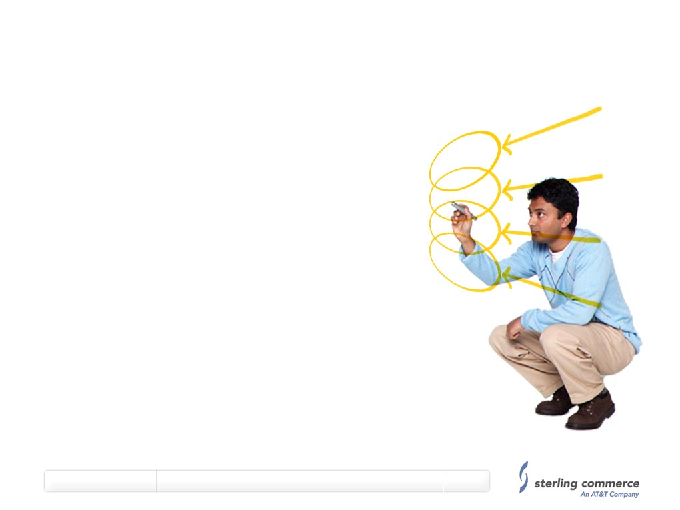
Sterling Promotions
Recommendations
A Business Release 1 perspective
Regarding Promotions at xpedx.
Sterling Commerce – July 11th 2010.

Slide 2
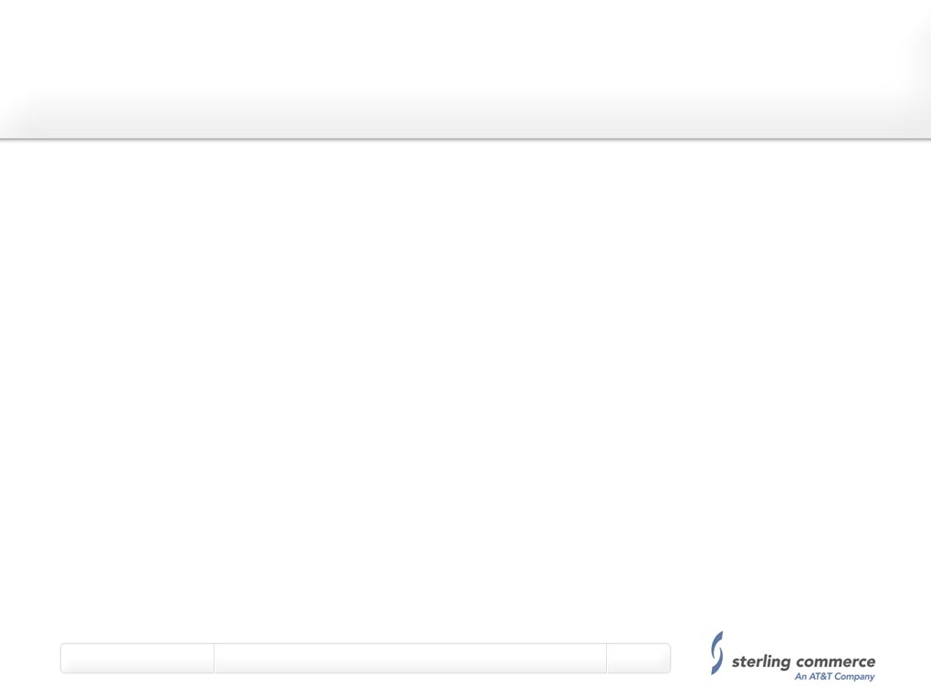
Topics
Promotions – a Sterling Perspective
Best Practices
Addressing xpedx Business Process Complexity
Strategic Recommendations

Slide 3
Promotions – A Sterling Perspective
Promotions have been a key capability since Web Commerce evolved.
  Also historically a core and rich capability in our Multi Channel Selling Suite
Architected and designed to be a Marketing and Sales Capability.
  Designed to enhance targeted sales initiatives.
    Focus on stock reduction opportunities, i.e. overstocks
    Encourage re-activation of inactive accounts.
    Engage with new clients as a competitive win strategy
NOT intended or designed to override fulfillment rules
Independent of other pricing strategies, i.e. contract pricing.
Summary is Promotions are Simple, Effective sales and marketing mechanism.

Slide 4
Promotions – Best Practice
The following key best practices have guided the design of the Promotions Engine in Sterling.
  Promotions should always be targeted.
    Focused on a customer, or set of customers
    Focused on a product and one product per promotion.
  Aligned with an Advertising and Marketing Strategy.
    Should be Limited in Duration and Scope, not become permanent BAU.
  Should take Precedence over normal business rules.
    Should over-ride contract pricing
For Businesses new to promotions, start out with simple, clear promotions and implement a Promotion effectiveness measurement strategy.
  Assists in determining which promotions work and which don’t.

Slide 5
Promotions – xpedx Business Complexity.
The xpedx Business Model is clearly a very complex one.
  It has the potential to negate the value proposition of promotions
  Could cause such systems or process complexity to cause promotions to become extremely unprofitable.
    For example
    Contract Pricing – which price is definitive, contract or promotion
    Orderable Total v Shippable Total – becomes a fulfillment process.
    Customers being tied to multiple divisions (via multiple ship to) when promotions tied to a division.
    Promotions as they impact order changes via CSR.
    Promotion impact on Minimum Order Charge.
    Promotions based on Attributes, i.e. Div, Segment, Region, Brand, Group.

Slide 6
Promotions – Strategic Recommendations.
Based on our experience with Sterling customers we recommend:
  Focus on starting simply and ramping up promotions over time:
  Implement a robust, effective Promotion effectiveness measurement system.
  Analyze, adjust, re-measure for a pilot period of time.
  Focus on the strategic best practices – they work.
    Promotions as a targeted, Marketing and Sales Engine.
    Promotions override other business rules.
    Keep them simple, effective and limited in Duration.
  Force some action on the customer part, for example.
    Tie a coupon code to reading an email, or an article, or the customer filling in a feedback form.

Slide 7
Promotions – Strategic Recommendations (ctd)
For BR1 – we recommend.
  A strategy of targeting coupons at specific customers.
    One Coupon per product, linked to targeted advertising.
  A strategy of targeting pricing rules for stock movement programs.
    Short, targeted programs to move over stock situations.
      For example, all customers in One Division.
Take advantage of the Sterling out of the Box Capabilities.
  Sterling delivered a simple, effective Promotions engine in the 9.0 code.
  Sterling plans to significantly enhance this Promotions engine over time.
Focus on implementing a Clear Promotions Strategy, and develop an effective measurements system to determine the success or otherwise of offered promotions.

Slide 8
Promotions – Strategic Recommendations (ctd)
For BR1 – we recommend.
  Avoid Custom Code and initial overly complex business rules.
    Promotion Pricing should be effective pricing.
    One Coupon per product.
    Target pricing rules as a mechanism for multiple products.
    Segmentation at the Customer and Division Level.
    Coupon impact on minimum order charge.
Start to add complexity in Later Business Releases.
  Additional Segments, Brands, Region, etc.
  Combining Coupons and Price rules.

